Slide 1
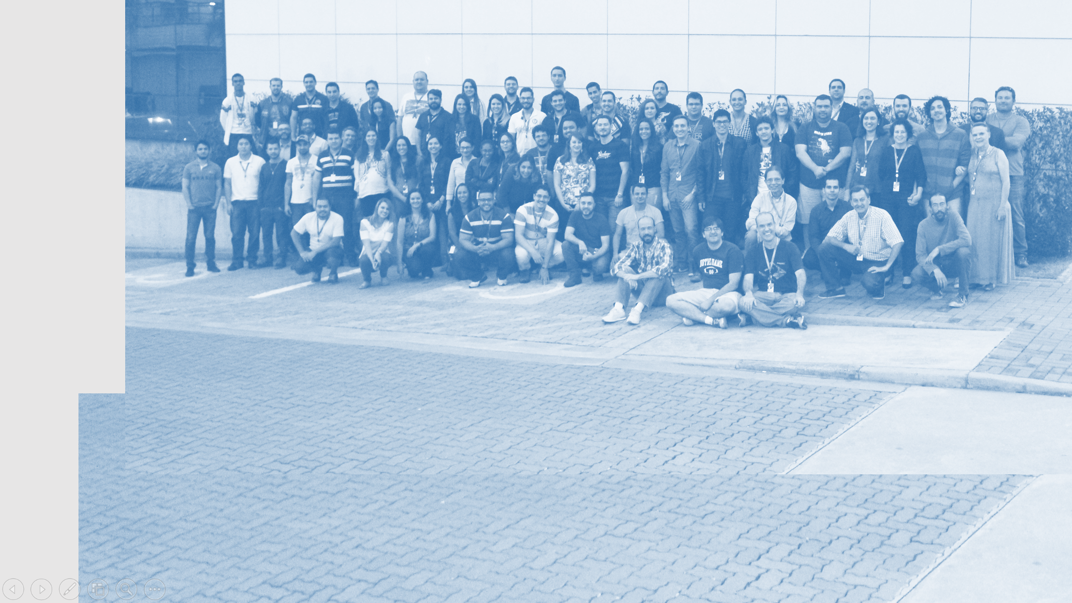
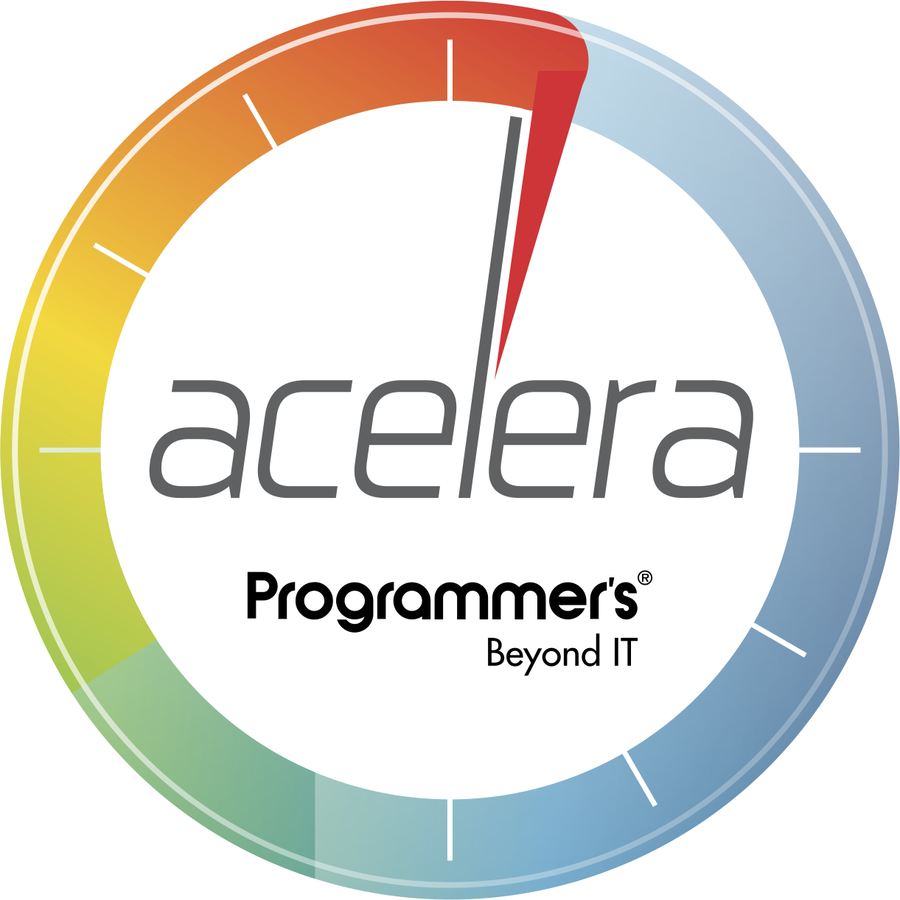

Automatização de testes em APIs utilizando Postman

Slide 2

API Requests
GET
POST
PUT
PATCH
DELETE
Workspaces
Mock Server
Collections
Test Runs
Newman + Docker
Jenkins Integration

Slide 3


